Slide 1
Briefing on Fire Drill
F11
Date: 25/8/2011
Thursday, 3.00 p.m.
By: Ben, SHO

Slide 2
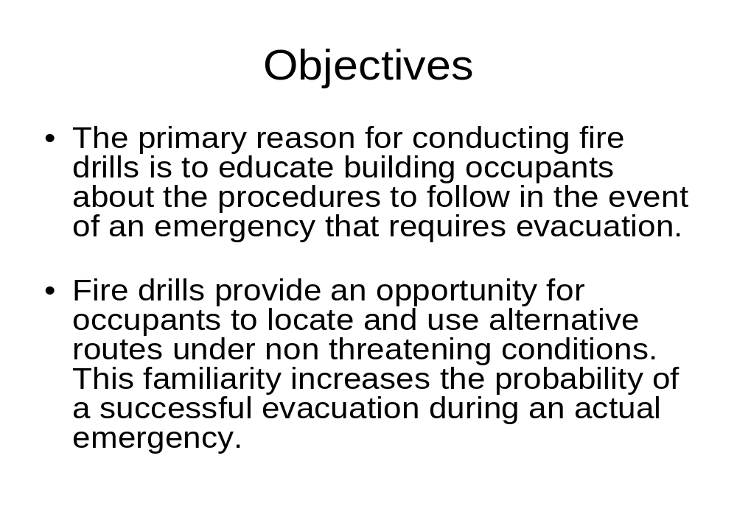

Slide 3
Emergency Response Team
Name | Role | Position
Mr. Toon Ka Keat | Emergency Commander | Assembly Area
En. Mohd Nizam | Deputy EMC | Assembly Area
Mr. Albert Go | Evacuation Controller | Assembly Area

Slide 4
Vijay | Fire Floor Marshal
Shafika | Fire Floor Marshal
Kiwi Lim | Fire Floor Marshal
Hamidi | Fire Floor Marshal
Ain Arizan | Fire Floor Marshal
Yap PJ | Fire Floor Marshal
Shahrizal | Fire Floor Marshal
Nurul Hidayah | Fire Floor Marshal
Najmuddin | Fire Floor Marshal
Loges | Fire Floor Marshal
Rosmam | Fire Floor Marshal

Slide 5
Janet Lau | Fire Floor Marshal
Tio TB | Fire Floor Marshal
Ishabudin | Fire Floor Marshal
Zahril | Fire Floor Marshal
Gerard Fong | Fire Floor Marshal
Stanley Lim | Fire Floor Marshal
Mohd Anizan | Search & Rescue | Assembly area
Jeremy Saw | Search & Rescue | Assembly area
Fazli | Fire Fighting Team | Assembly area
Emily Ong | Fire Fighting Team | Assembly area
Sharmini | First Aider | Assembly area
Nurzaman | First Aider | Assembly area
Arshad | Security Controller | Assembly area

Slide 6
Emergency Commander (EMC)
Toon & Nizam
Overall control of incident
Operates from Fire Control Room / Assembly area
Determine location of fire
Formulate control actions and advise
Mobilize Fire Fighting team
Liaise with Fire and Police Department

Slide 7
Evacuation Controller (EC)
Albert
In-charge of evacuation
To be present at assembly area
Co-ordinate with Security Controller
Roll Call & Verify missing persons
Co-ordinate with First Aid Team

Slide 8
Fire Floor Marshal (FFM)
To lead occupants to the staircase and to the assembly area
Line them up for the roll call, do head count
Inform the EC of missing persons and number of head count
Assist in re-entry process

Slide 9
Search and Rescue Team
Mohd Anizan & Jeremy
To search and rescue occupants / victims
To lead victims/handicapped to the assembly area, if any
Report status to Emergency Commander

Slide 10
Fire Fighting Team
Fazli & Emily
Fighting fire
Reports status to Emergency Commander

Slide 11
Security Controller (SC)
Arshad
In-charge of Building Security
Control human movements
Ensure vehicle movement is stopped
Deploy security personnel to road junction
Ensure clear access for emergency services

Slide 12
First Aid Team
Sharmini & Nurzaman
Keep team advised of any injury / serious injury or casualty
Assists in treatment of casualties and render first aid as required
Make arrangement for ambulance
Report status to Emergency Commander

Slide 13
CHRONOLOGICAL PLAN
9.30 a.m. | ERT members to gather at AA for a briefing by Emergency Commander (Toon). All members are ready with necessary equipment i.e. walkie-talkie, first aid kit, placards, loud hailer, etc | ERC
9.45 a.m. | ERT members to be at their respective locations / floors and check all the exits are not blocked. Communicate with Toon on your readiness to start the drill through walkie-talkie. | ERT
10.00 a.m. | Alarm activated after Toon giving 10 seconds’ count down. Fire Floor Marshals to gather occupants and lead them to the nearest staircase/exits and lead them to assembly area | Maintenance Dept/FFM

Slide 14
10.20 a.m. | Assembled at assembly area. Fire floor marshals to do roll call and head count and report any missing persons to Albert. Albert to brief the occupants on the evacuation procedures. | FFM/EC
10.35 a.m. | Briefing by Emergency Commander | EMC
10.45 a.m. | Emergency Commander announces for occupant re-entry into the building. Fire Floor Marshals to assist the progress. | EMC
11.10 a.m. | Post mortem meeting at F11 meeting room. | ERT

Slide 15
Thank You

